Slide 1
Project 2
EXCEL (Pivot Table ) & DATABASE( Hospital information system)
Submitted to :
Vicky Tao
Submitted by :
Manish Kataria (W0865937)
Sahil (W0861930)
Parbhjot Kaur (W0859954) Hang Yu (W0873466)
Yan Guo (W0869884)
Rohan Batra (W0863398)
Pallvi (W0865940)

Slide 2
Contents
Part A excel---Pivot table
VLOOKUP function
Part B database--- Hospital information system requirements
Carding relevant information
ERD & cardinalities
Conclusion

Slide 3
PART-A
EXCEL

Slide 4
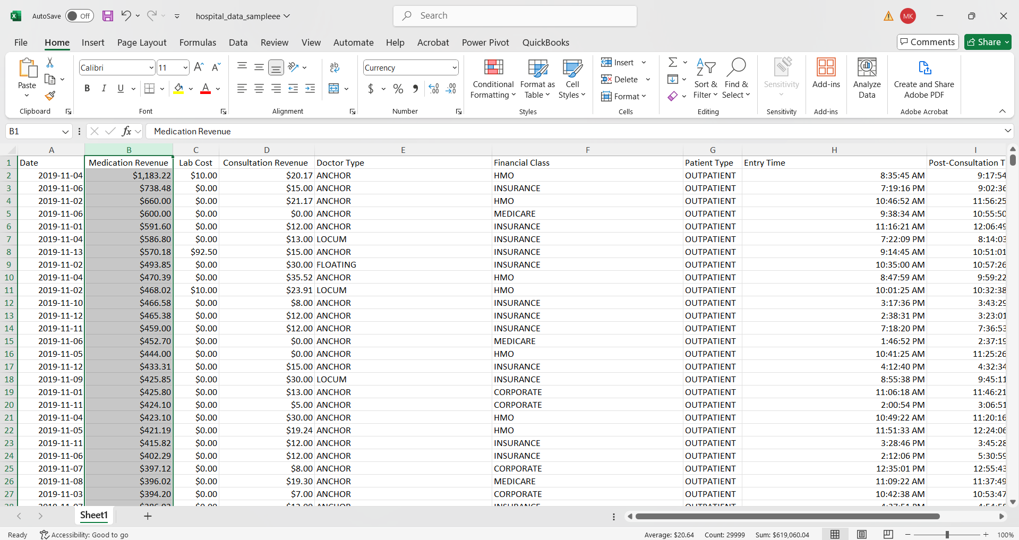
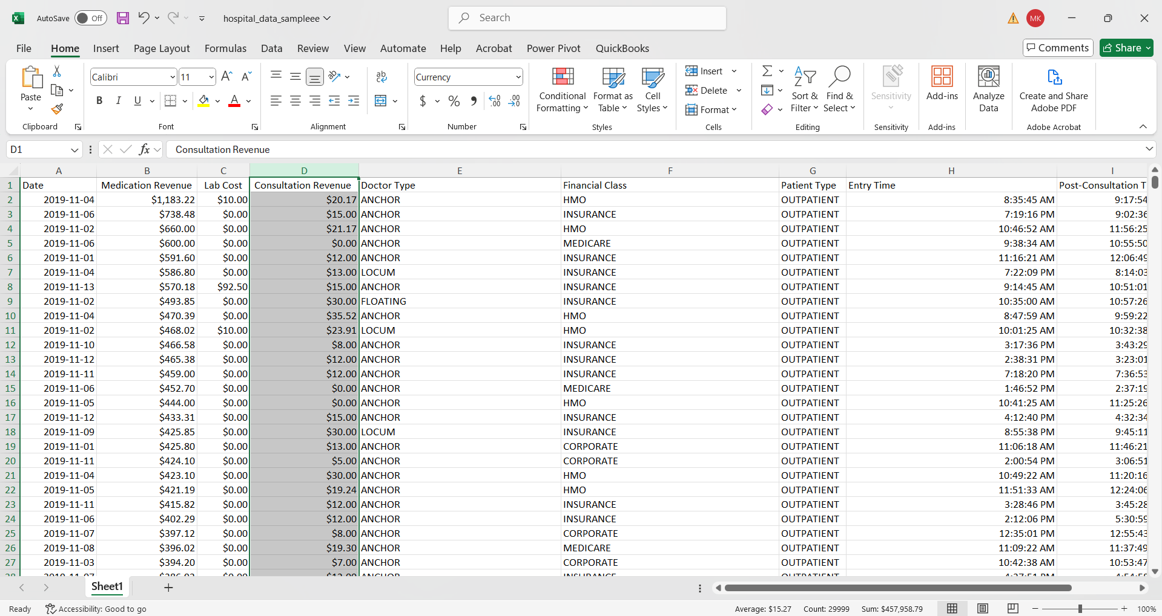
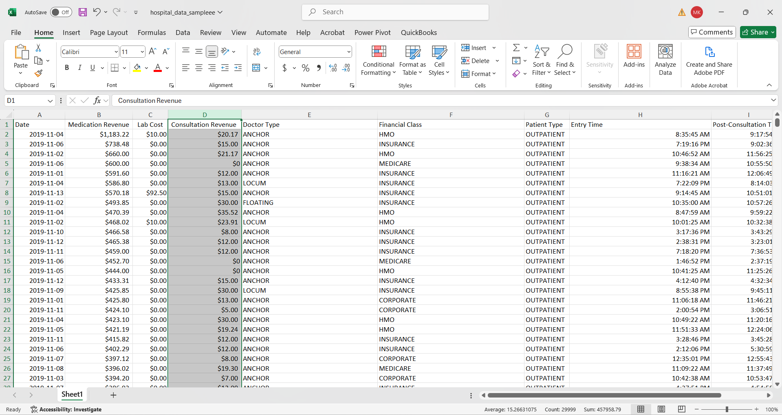
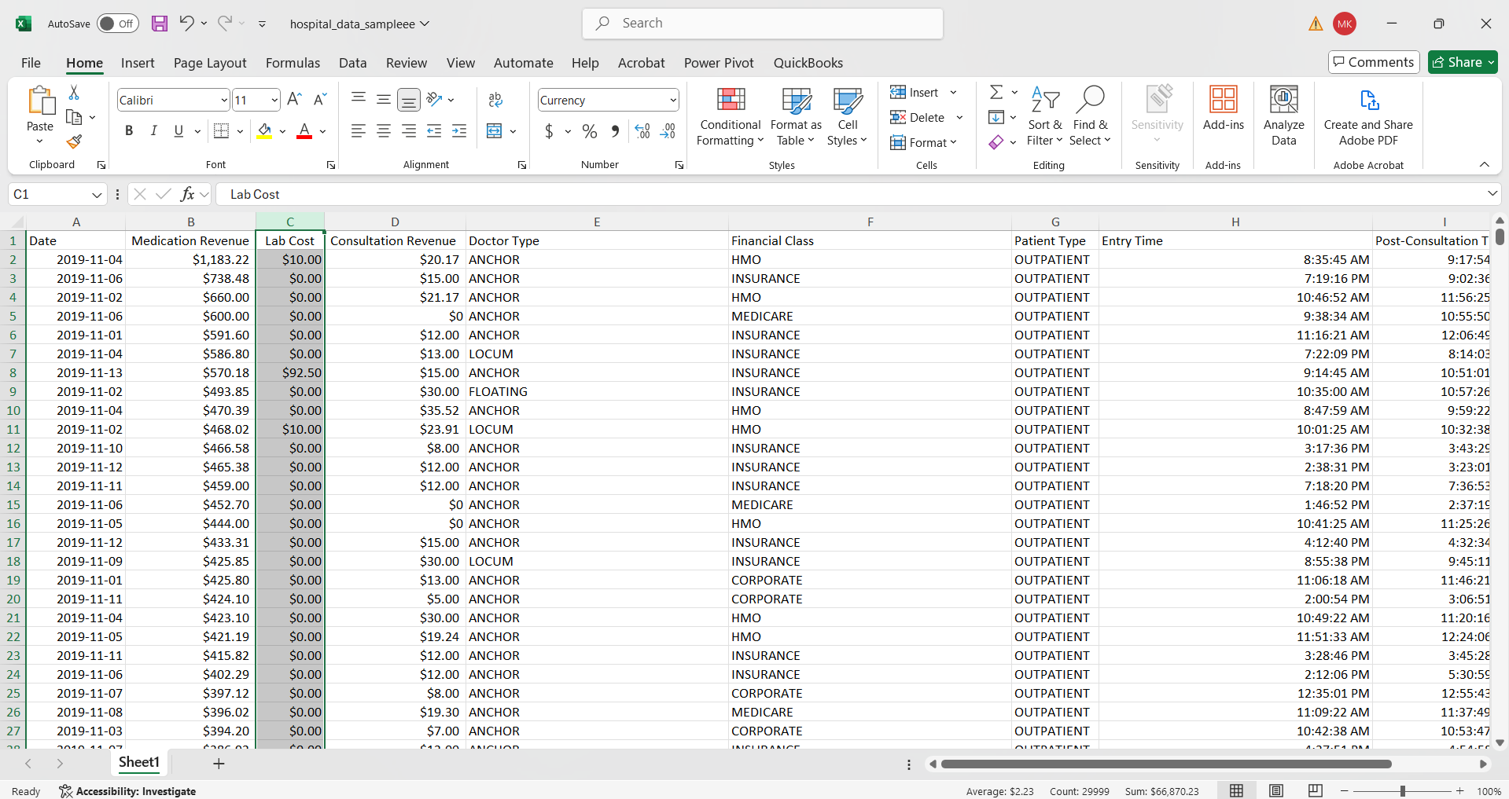
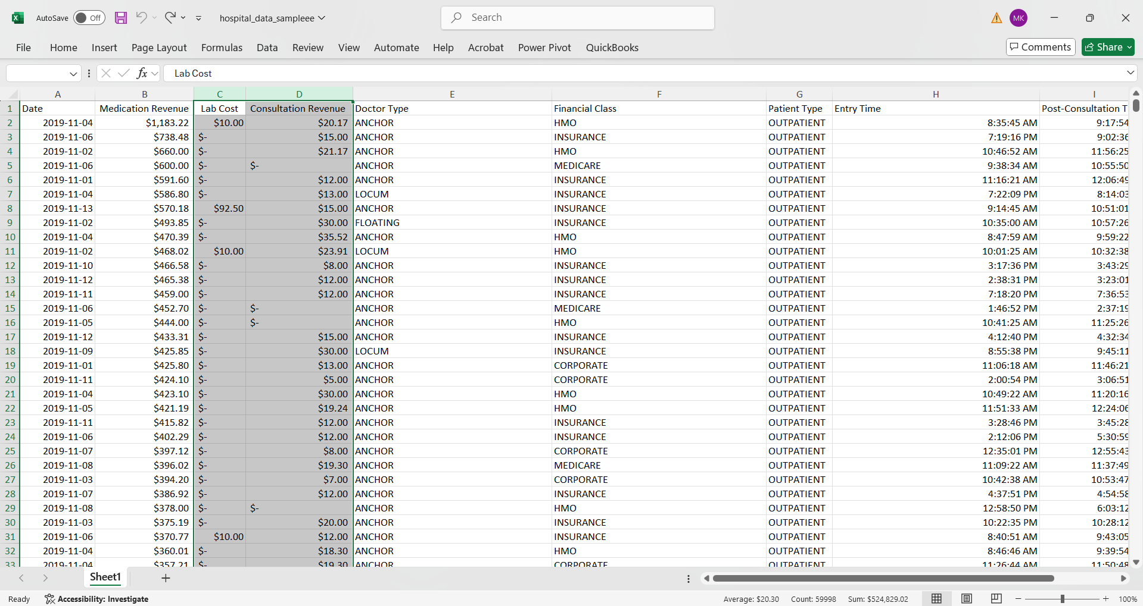
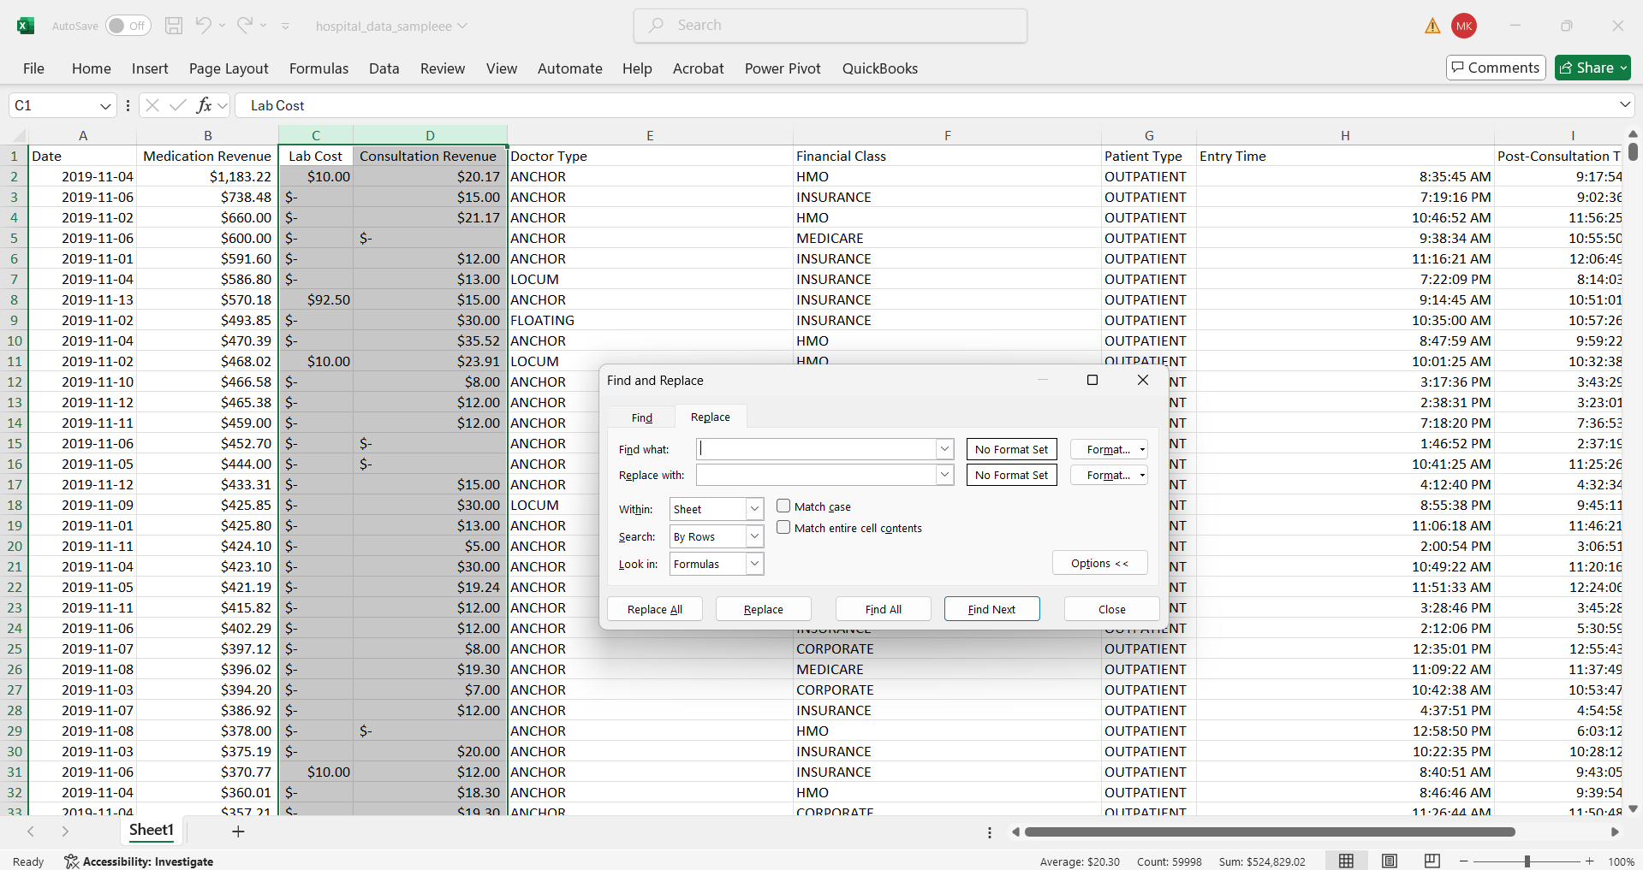
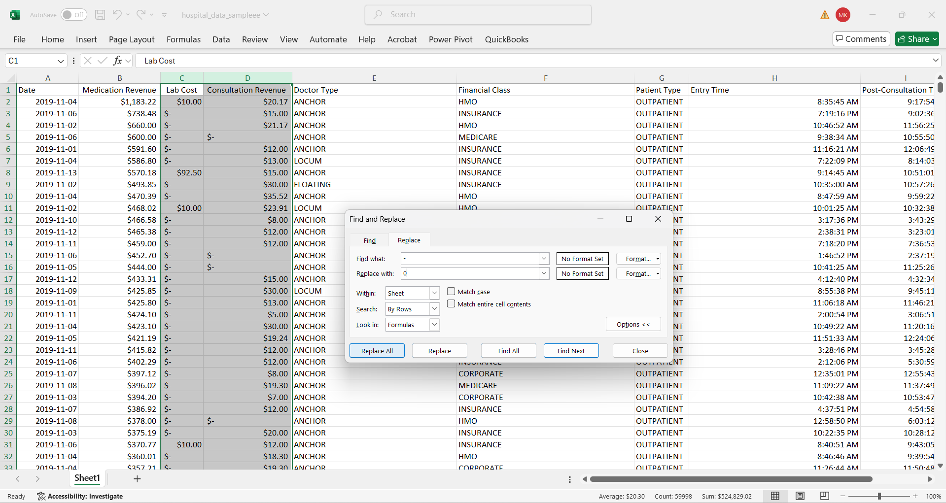
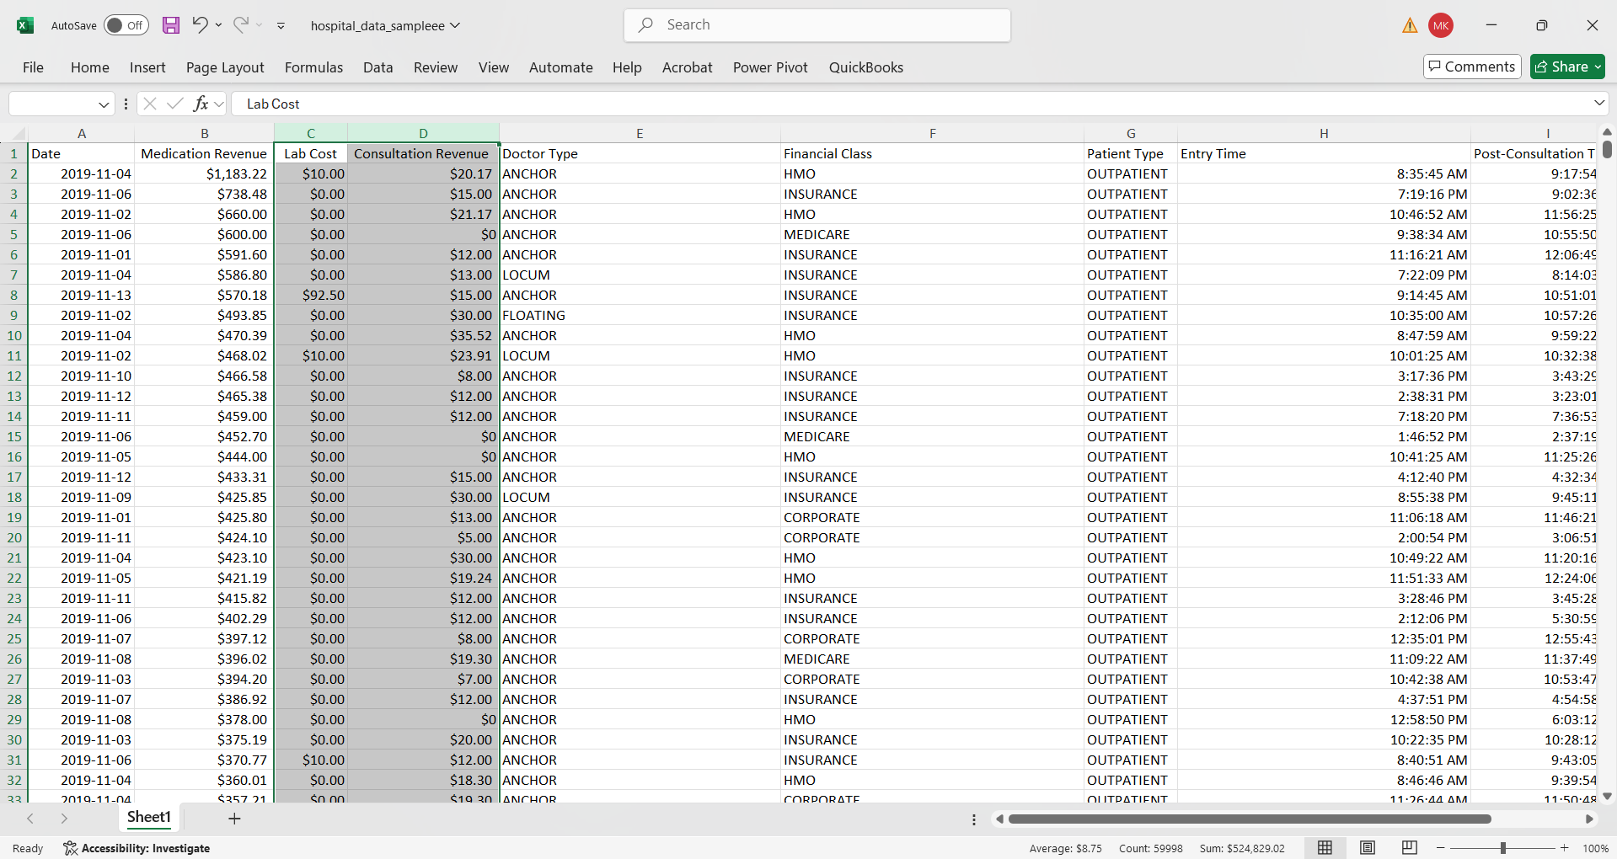
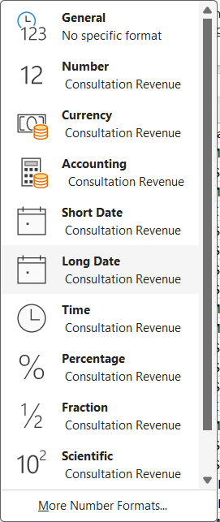
Data Handling
Ctrl + h

Slide 5
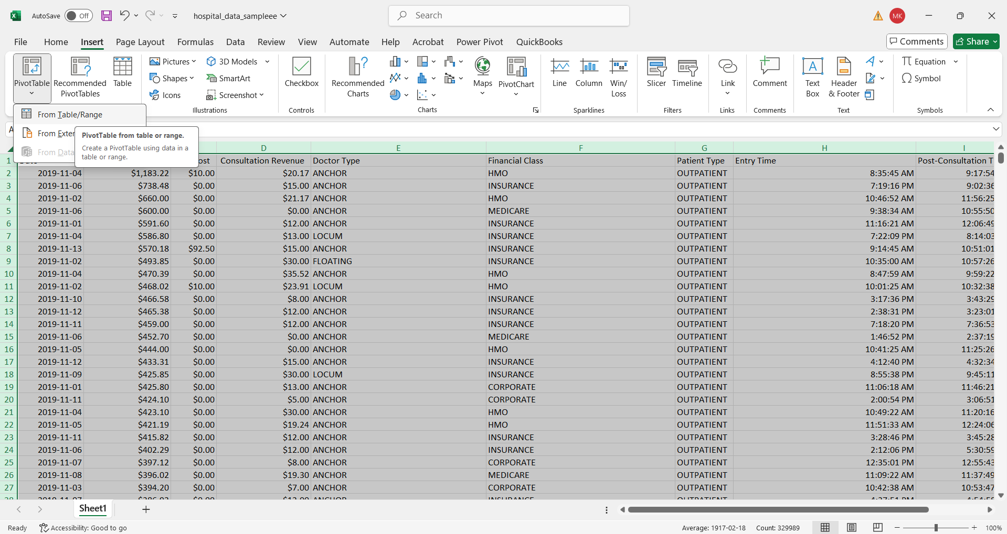
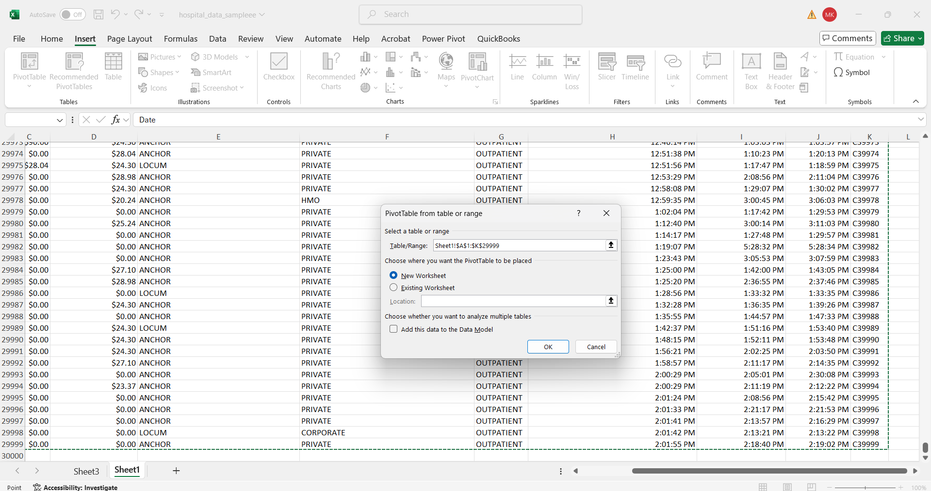
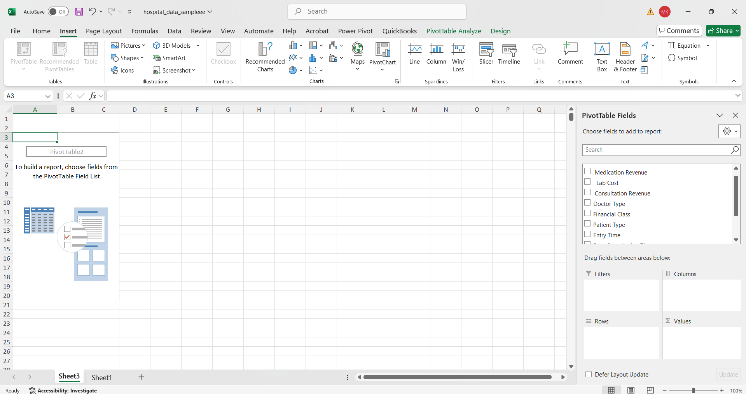
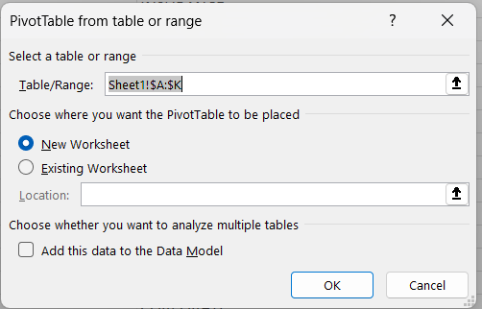
Pivot Table

Slide 6


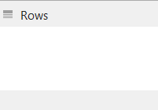

Pivot Table - Fields
Add the data as rows in pivot table.
Add the values pivot table.
To filter the rows , columns and values in data in pivot table.
Add the data as column in pivot table.

Slide 7
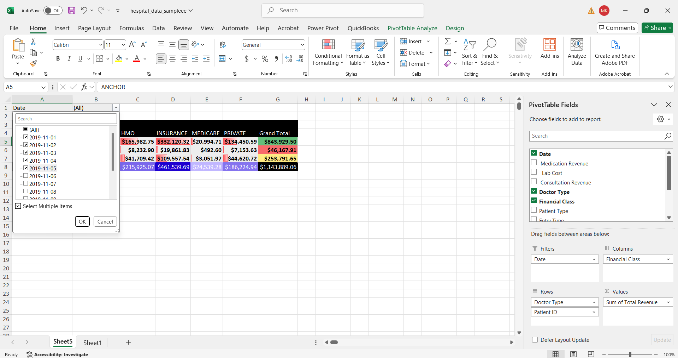
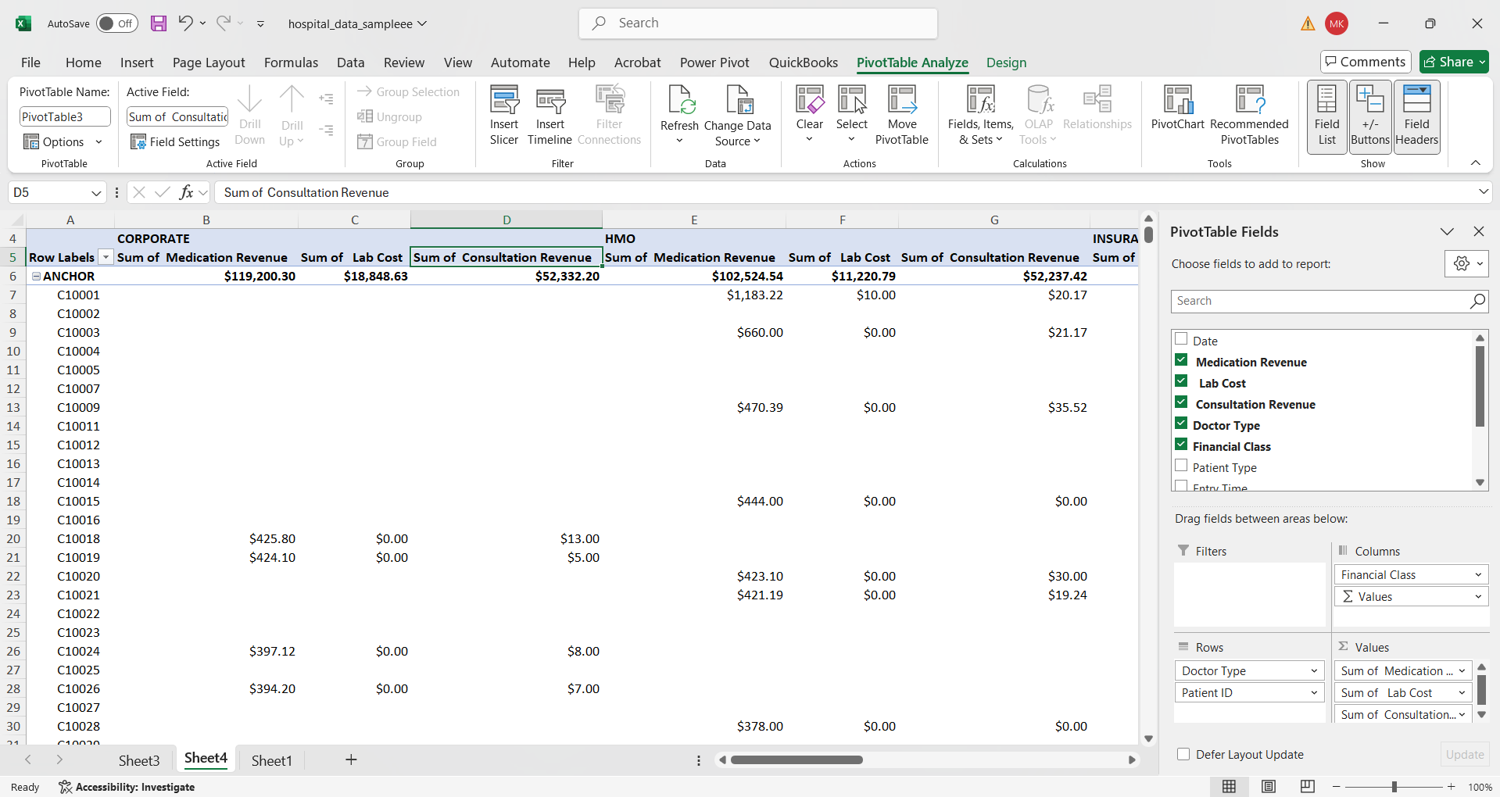
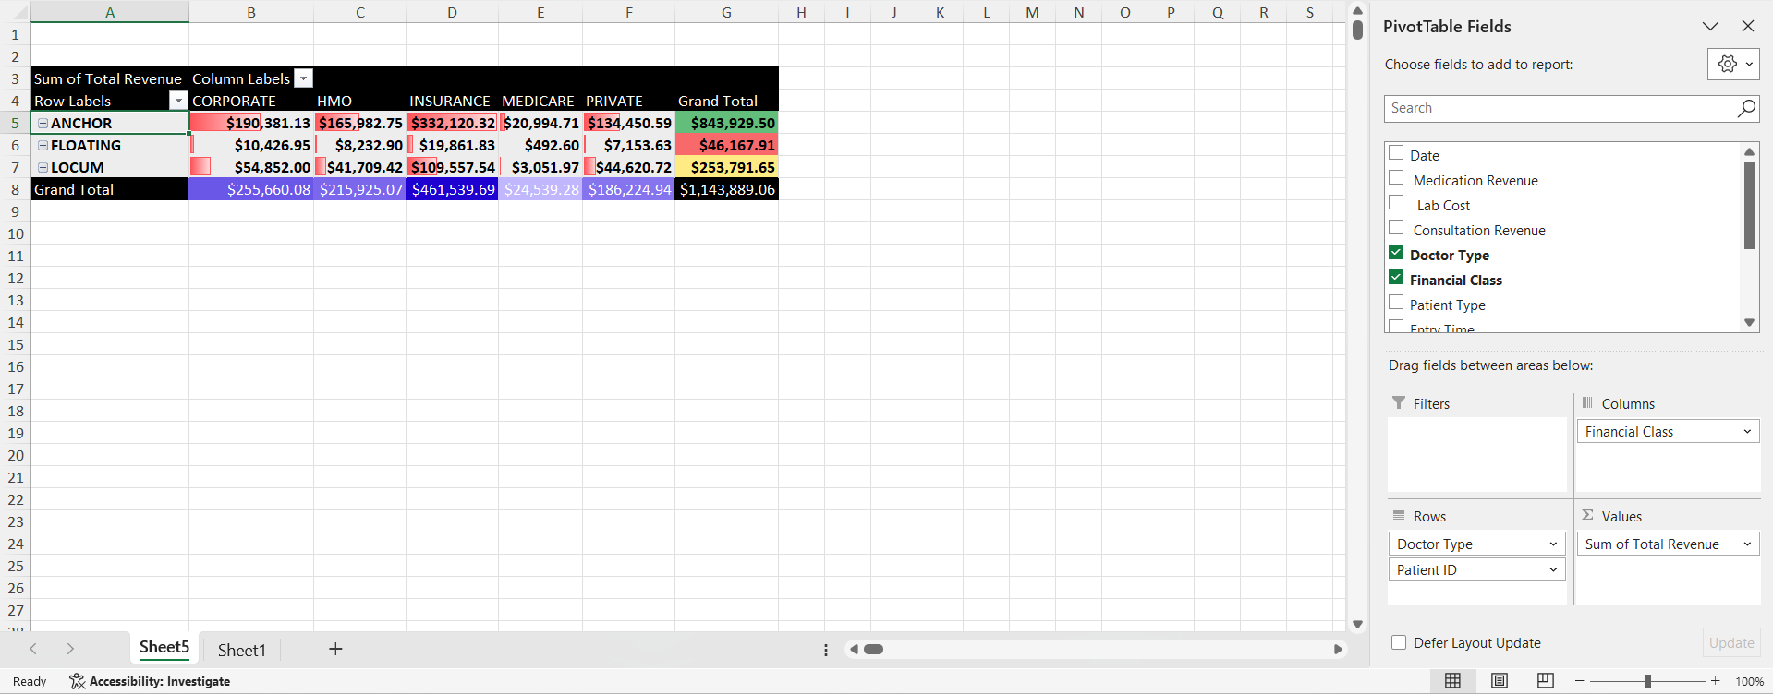
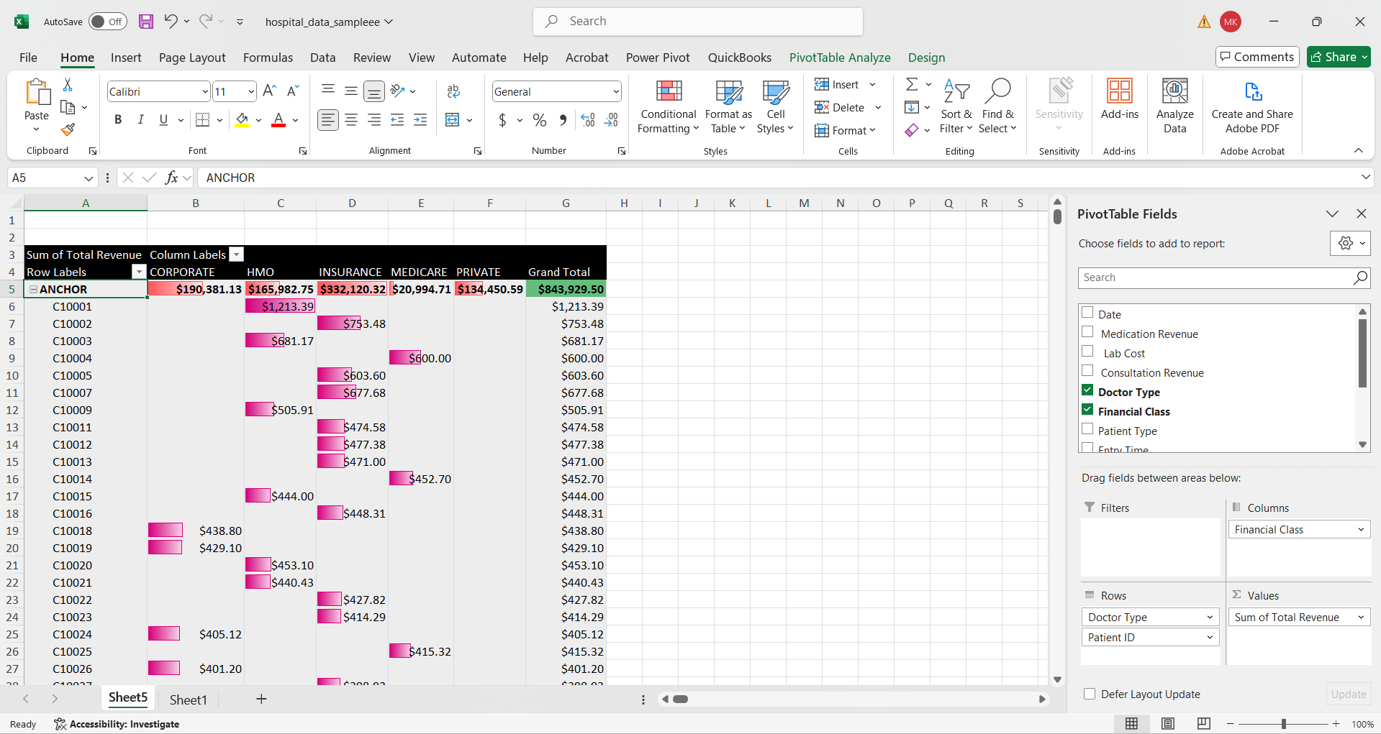
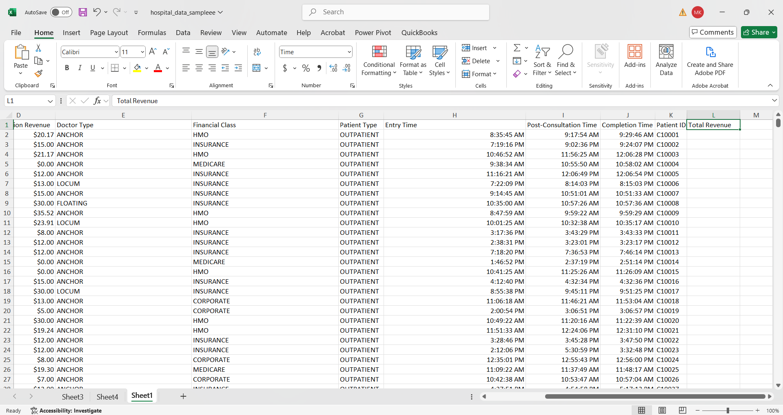
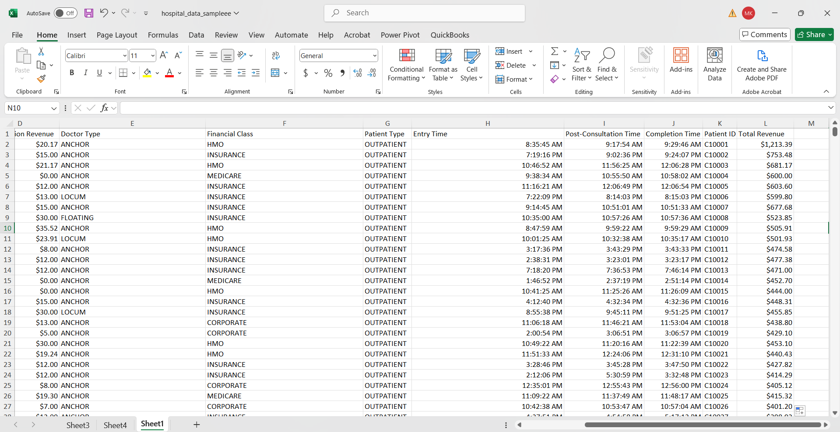
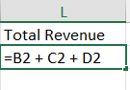
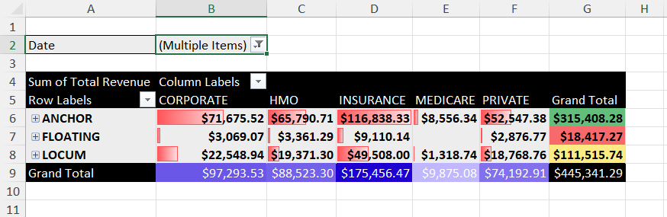
Pivot Table
Before
Medication Revenue
Lab Cost
Consultation Revenue
After

Slide 8
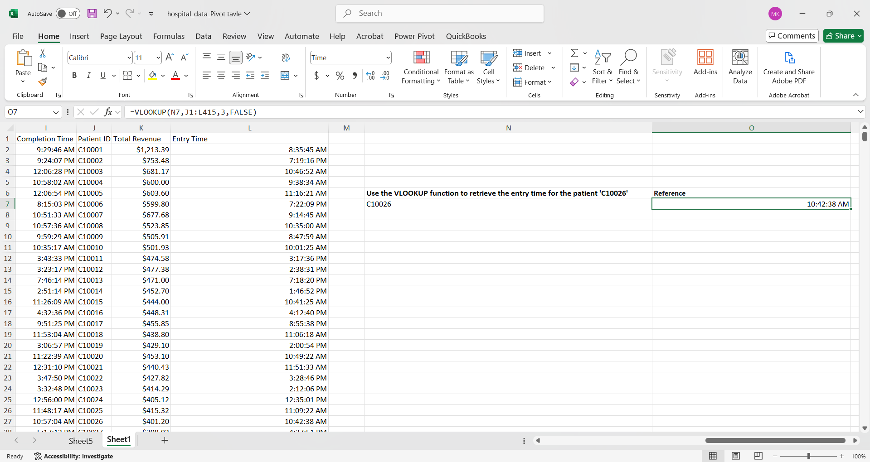
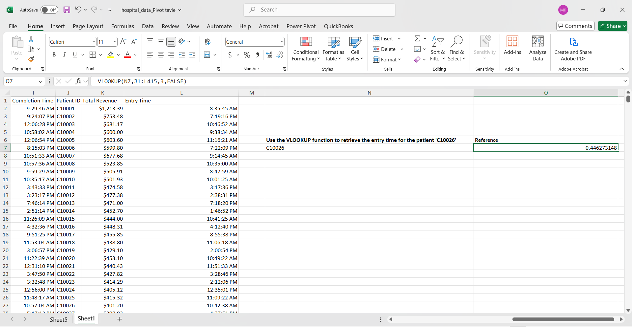
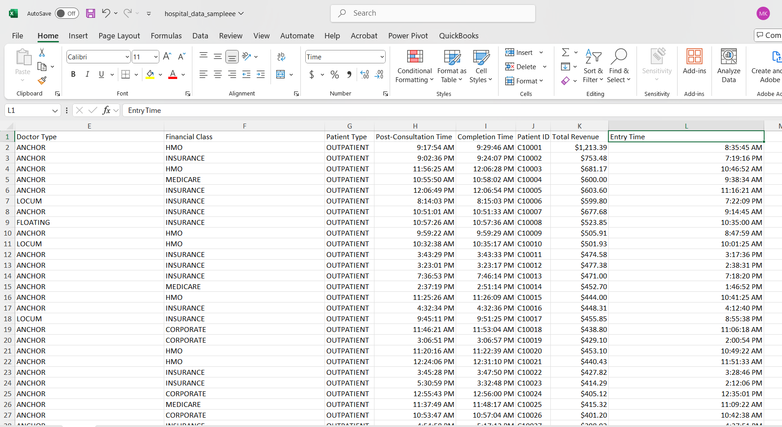
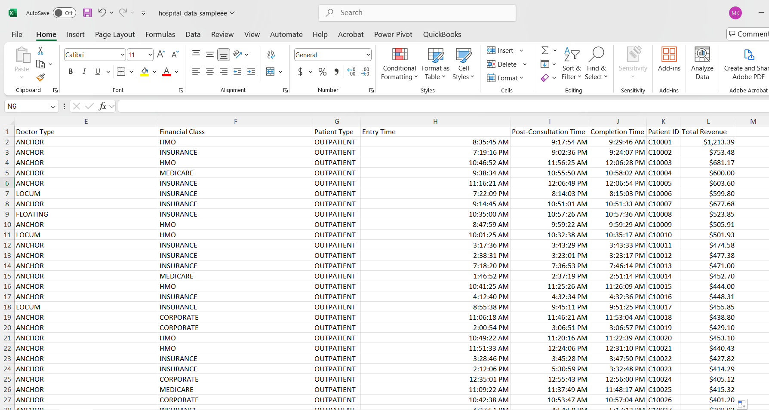
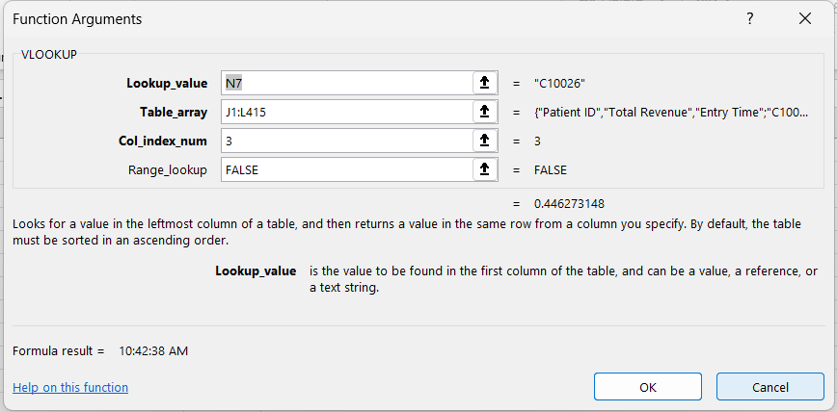
VLOOK Function

Slide 9
PART-B
DATABASE and ERD

Slide 10
Database Requirements
Hospital Blocks
2
Doctors Nurses and Other Management
Patient information, Bill Management and
Ward block, Private Rooms,, Operation Theater, Medical Supplies and Other Management
1
3
Hospital Staff
Patient Management

Slide 11
Entity Relationship Diagram
PK
Primary Key
UK
Keys
Unique Key
?
FK
Optionality
Foreign Key
ABC
*
Column Name
Compulsory
°
Not Compulsory

Slide 12
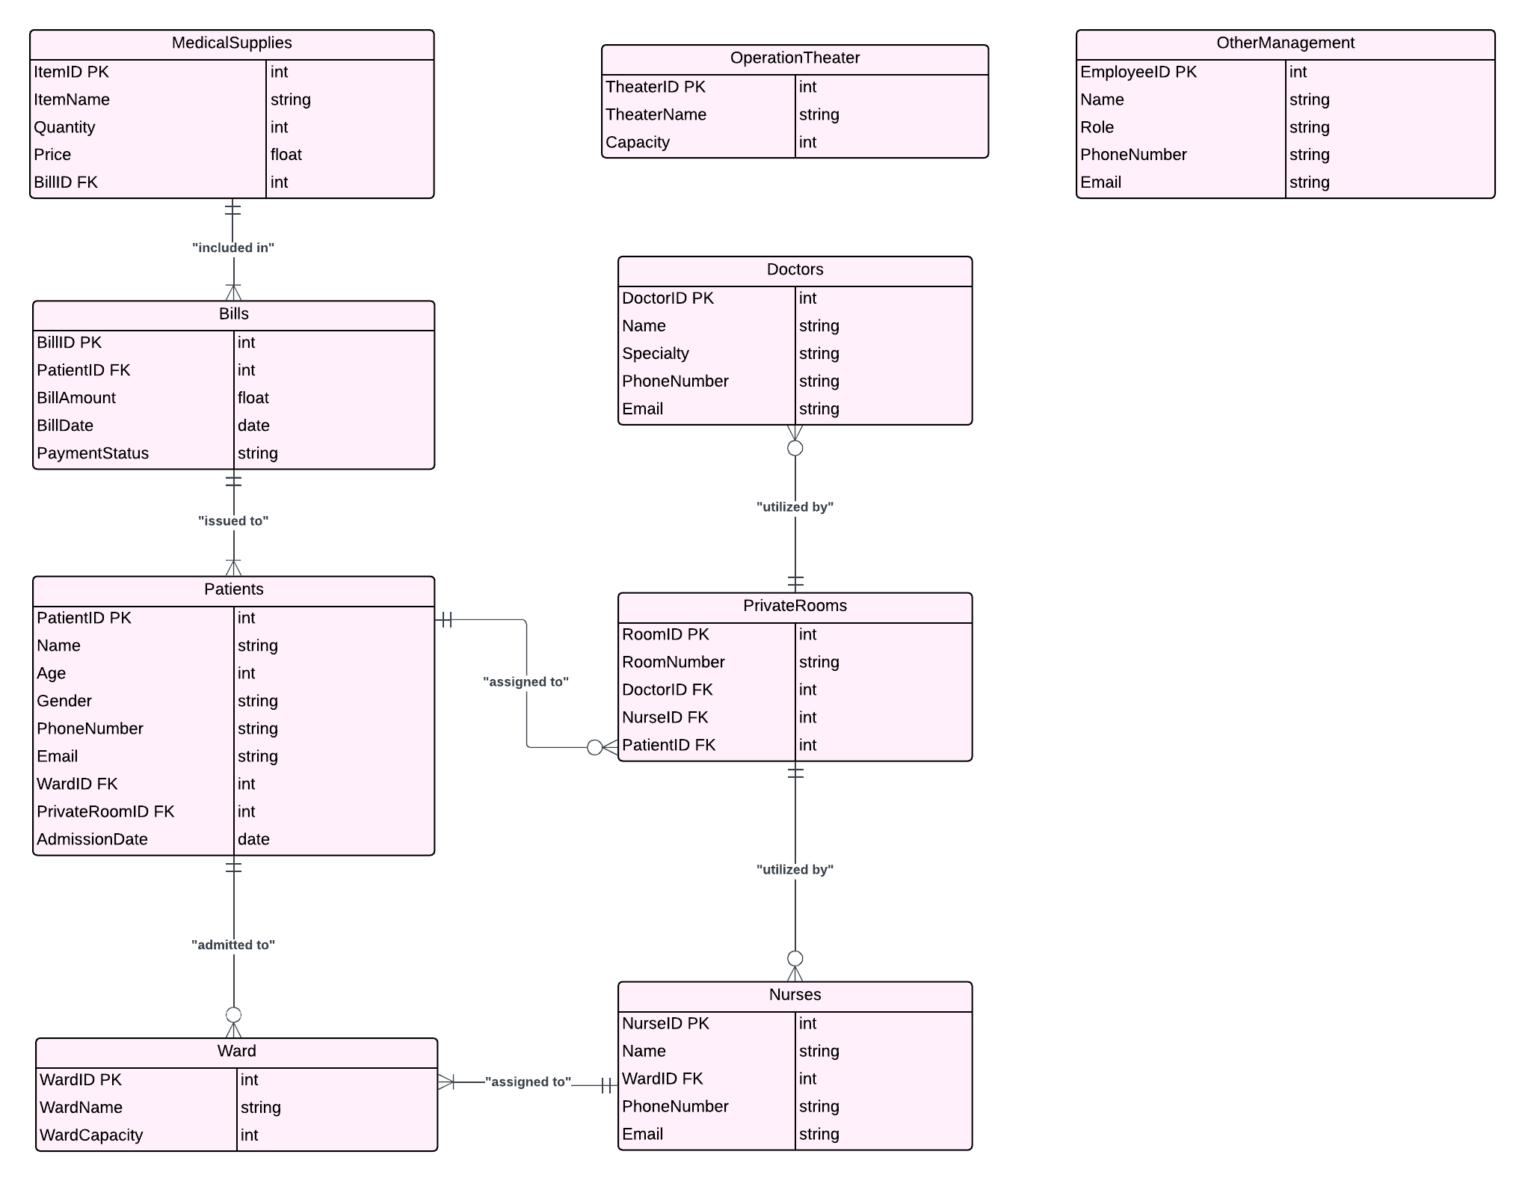
Entity Relationship Diagram

Slide 13
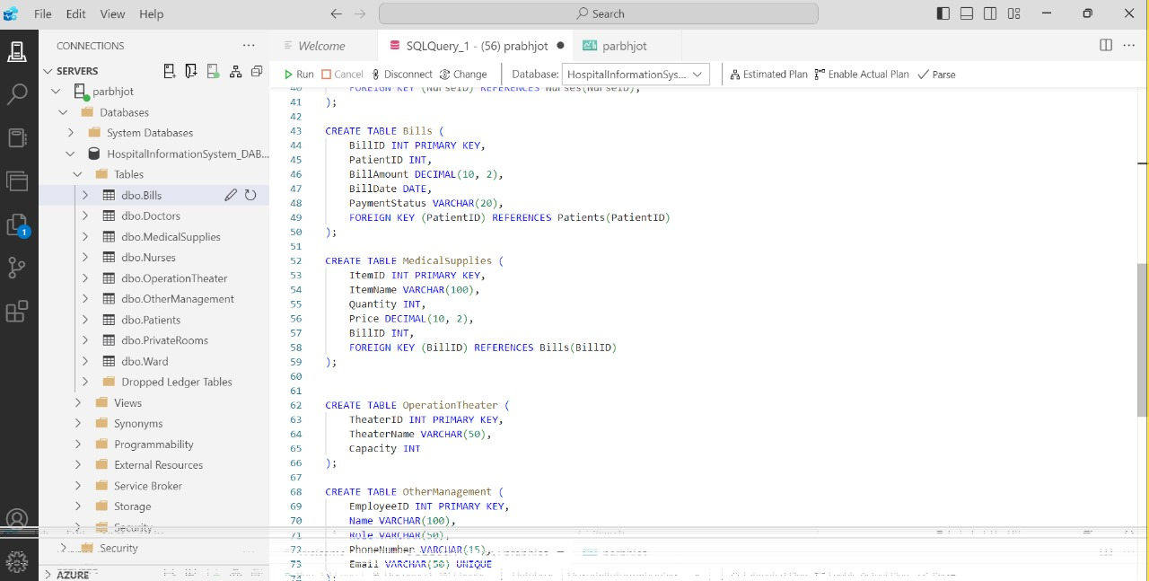
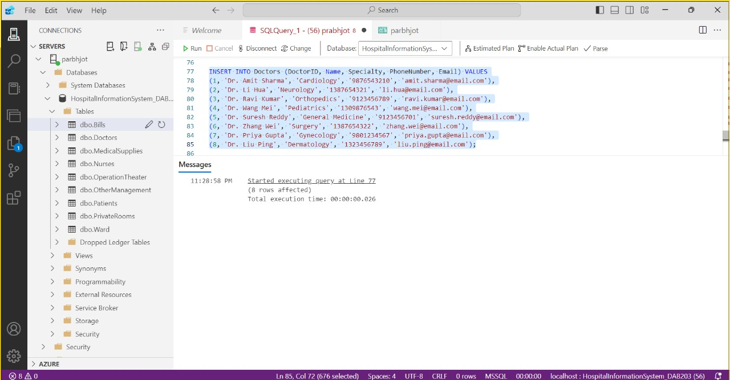
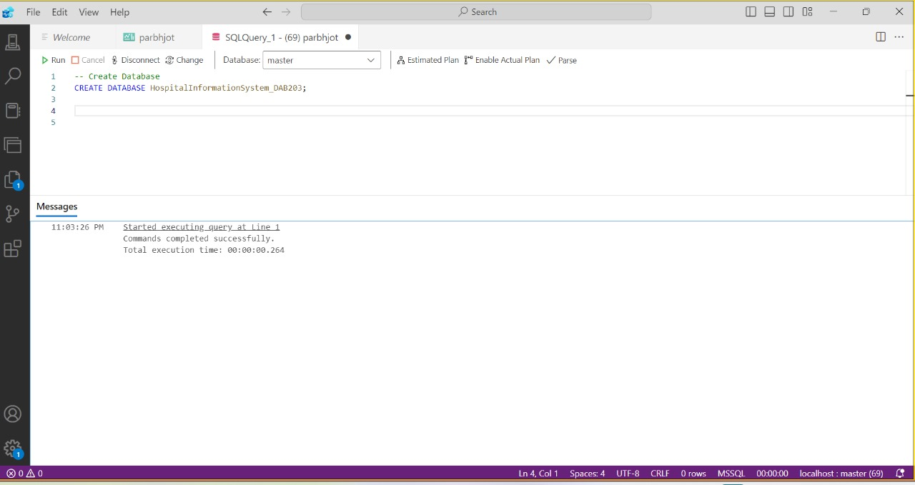
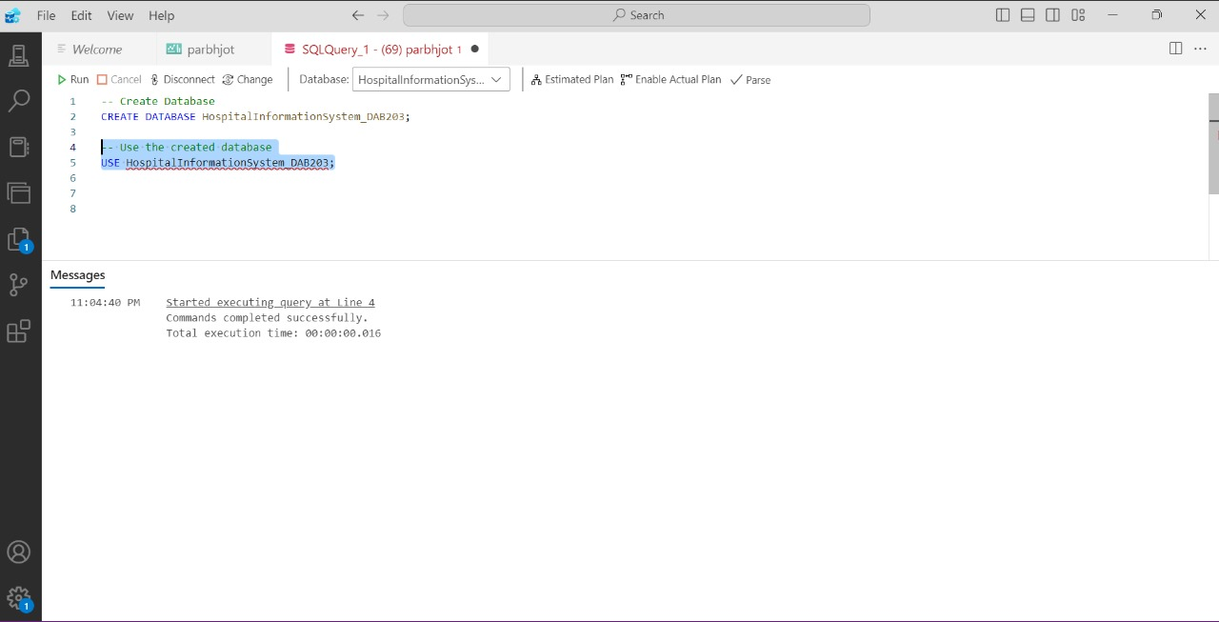
Database Building

Slide 14
Conclusion
Pivot Table Benefits
Data Summarization
Dynamic Analysis
Data Aggregation
Filtering and Sorting
Entity-Relationship Diagram (ERD)
Clear Visual Representation
Database Design and Structure
Improved Communication
Data Integrity
Simplifies Database Maintenance
Error Detection
VLOOKUP Function
Efficient Data Lookup
Data Integration
Accuracy
Flexible Range

Slide 15
THANKS

